Slide 1
Text to Sql project
By Alex Cianfoni
Llm used chatgpt and version 3.5

Slide 2
grading
The grading methodology would be, for each question 5 points would be awarded for a question correct and 5 points taken way for a question being wrong.
Points off for each time it has to be corrected
loss of points for if it not working or if it doesn’t give you the desired answer
Points for simplicity

Slide 3
Question 1
Prompt :
--1. Display the cities that makes the most different kinds of products. Experiment with the rank() function.

Slide 4
Code grade and fix
SELECT
city,
COUNT(DISTINCT prodId) AS num_products
FROM
Products
GROUP BY
city
ORDER BY
COUNT(DISTINCT prodId) DESC
LIMIT 1;
4/5
Only needed 1 fix and that was to simplify the code.

Slide 5
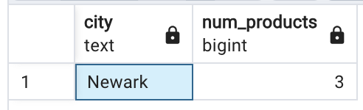
Results of the code
The results between my code and the llm where the same.

Slide 6
Question 2
--2. Display the names of products whose priceUSD is less than 1% of the average priceUSD, in alphabetical order. from A to Z.

Slide 7
Code grade and fix
SELECT
name
FROM
Products
WHERE
priceUSD < (SELECT AVG(priceUSD) * 0.01 FROM Products)
ORDER BY
name ASC;
4/5
Only needed 1 fix and that was to simplify the code.

Slide 8
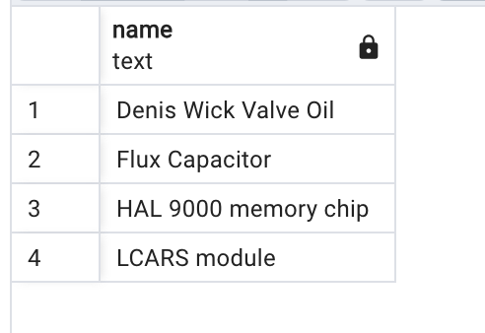
Results of the code
The results between my code and the llm where the same.

Slide 9
Question 3
--3. Display the customer last name, product id ordered, and the totalUSD for all orders made in March of any year, sorted by totalUSD from low to high.

Slide 10
Code grade and fix
SELECT
p.lastName AS customer_last_name,
o.prodId AS product_id_ordered,
o.totalUSD
FROM
Orders o
JOIN
Customers c ON o.custId = c.pid
JOIN
People p ON c.pid = p.pid
WHERE
EXTRACT(MONTH FROM o.dateOrdered) = 3
ORDER BY
o.totalUSD;
4/5
Only needed 1 fix and that was to simplify the code.

Slide 11
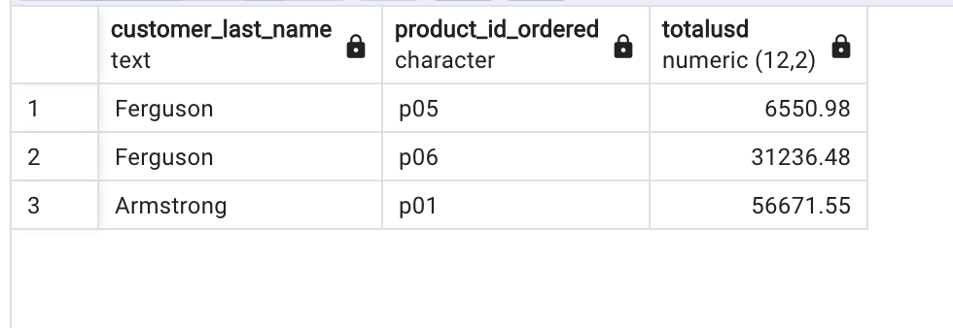
Results of the code
The results between my code and the llm where the same.

Slide 12
Question 4
--4. Display the last name of all customers (in reverse alphabetical order) and their total ordered by customer, and nothing more.
--Use coalesce to avoid showing NULL totals.

Slide 13
Code grade and fix
SELECT
p.lastName AS customer_last_name,
COALESCE(SUM(o.totalUSD), 0) AS total_ordered
FROM
Customers c
LEFT JOIN
Orders o ON c.pid = o.custId
LEFT JOIN
People p ON c.pid = p.pid
GROUP BY
p.lastName
ORDER BY
p.lastName DESC;
3/5
The first time it showed all people not just customers. So I told it to just show only customers not people.

Slide 14
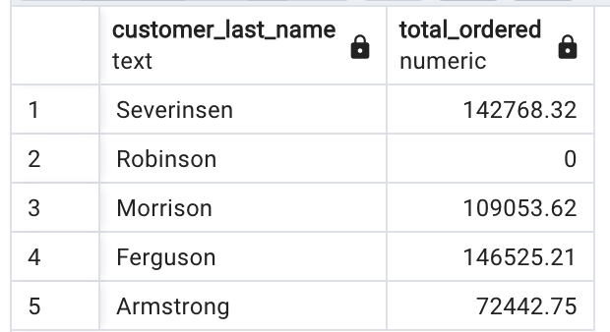
Results of the code of the llm
The final results between the llm and my code where the same.

Slide 15
Question 5
--5. Display the names of all customers who bought products from agents based in Chilliwack along with the names of the products they ordered,
-- and the names of the agents who sold it to them.

Slide 16
Code grade and fix
SELECT
p.lastName AS customer_name,
pr.name AS product_name,
a.firstName || ' ' || a.lastName AS agent_name
FROM
Orders o
JOIN
Customers c ON o.custId = c.pid
JOIN
People p ON c.pid = p.pid
JOIN
Products pr ON o.prodId = pr.prodId
JOIN
Agents ag ON o.agentId = ag.pid
JOIN
People a ON ag.pid = a.pid
WHERE
a.homeCity = 'Chilliwack';
4/5
The first time it showed all people not just customers. So I told it to just show only customers not people.

Slide 17
Results of the code of the llm
The final results between the llm and my code where the same.

Slide 18
Question 6
--6. Write a query to check the accuracy of the totalUSD column in the Orders table.
--This means calculating Orders.totalUSD from data in other tables and comparing those values to the values in Orders.totalUSD.
--Display all rows in Orders where Orders.totalUSD is incorrect, if any. If there are any incorrect values, explain why they are wrong.
--Round to exactly two decimal places.

Slide 19
Code grade and fix
SELECT
o.*,
ROUND(SUM(pr.priceUSD * o.quantityOrdered), 2) AS calculated_total
FROM
Orders o
JOIN
Products pr ON o.prodId = pr.prodId
GROUP BY
o.orderNum
HAVING
ROUND(SUM(pr.priceUSD * o.quantityOrdered), 2) != o.totalUSD;
4/5
Gave pointless info.

Slide 20
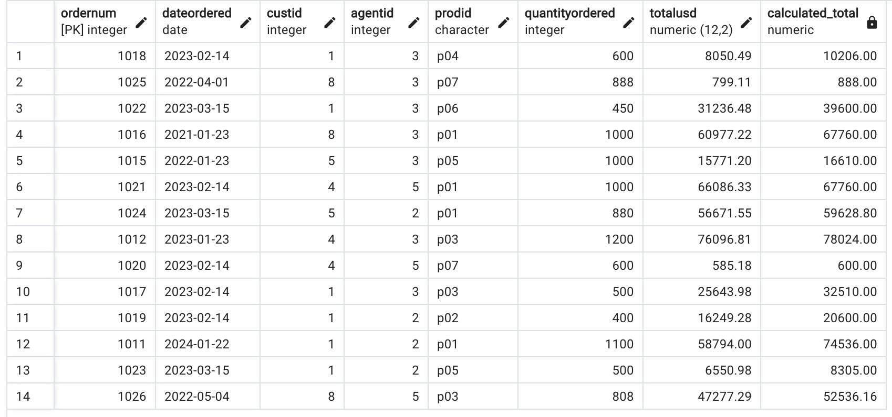
Results of the code of the llm
The final results between the llm and my code where the same.
Apart from the extra code and
Info

Slide 21
Questions 7
--7. Display the first and last name of all customers who are also agents.

Slide 22
Code grade and fix
SELECT
c.firstName AS first_name,
c.lastName AS last_name
FROM
People c
JOIN
Customers cu ON c.pid = cu.pid
JOIN
Agents a ON c.pid = a.pid;
5/5
It was spotless.

Slide 23
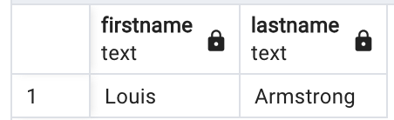
Results of the code of the llm
The final results between the llm and my code where the same.

Slide 24
References
ChatGPT

Slide 25
Opinions
The LLM worked for the most part In answering the questions. It worked well and was smooth and seamless. The only drawback to using it was that I needed to simplify the answers it was giving me. The overall grade would be an 80 overall.

